Slide 1
CIS 5560 Machine learning
Microsoft Azure Machine learning Studio
&
DATABRICKS

Slide 2
Presented by:- (Group- h)
KRITHY NANAIAH ATRANGADA (CIN: 305903525)
NEHA SHASHIDHARA GULI (CIN: 305848990)
ANUPAM SAHAY (CIN: 305903512)

Slide 3
DATA SET Specifications :
San Francisco Bay Area Bike Share.
Link (https://www.kaggle.com/benhamner/sf-bay-area-bike-share/data)
Size of the data: 4.45GB
Contents of the dataset: station.csv, status.csv, trip.csv, weather.csv

Slide 4
Homework Experimental specifications
Data Bricks Specifications:
Execution: Single Node
Memory: 6GB Capacity
Databricks Runtime Version: 4.0(Incl. Apache Spark 2.3.0, Scala 2.11)
Microsoft Azure Machine Learning Studio Specification:
Execution: Single Node
Storage Space Capacity: 10 GB Memory
Compute Resource Type: ML service is a multitenant service.

Slide 5
Predictive Model: SF Bay Area Bike Sharing
We have created a model to predict the number of trips taken on a particular
day.
We are using all the information and data provided by the SF bike sharing
company i.e. weather report, number of bikes available, type of
days(Business day v/s Holiday v/s Weekends )
We treat Business days as 1 and Holidays or Weekends as 0
We have checked if the stations were repeated or listed only once
We have split the data in train and test in the ratio of 0.8 0.2
We have checked for distinct weather events i.e. rain, fog, normal day etc.
We have checked for any outliers in the data.

Slide 6
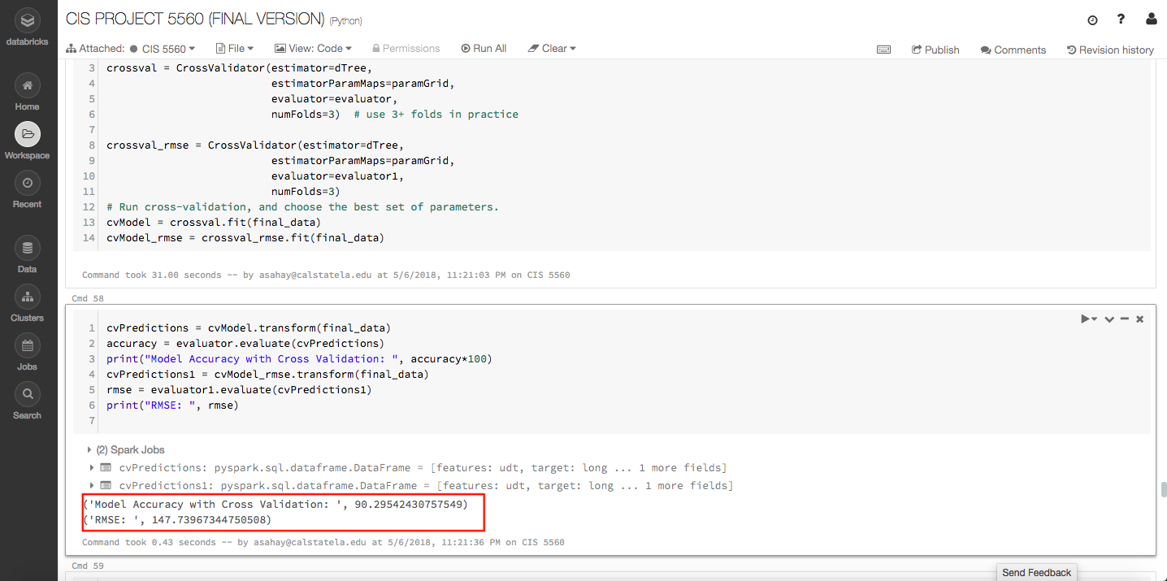
DATA Bricks (SPARK Machine Learning)
MODEL 1:
ALGORITHM USED : DECISION TREE REGRESSION
MODEL ACCURACY WITH CROSS VALIDATION : 90.295
ROOT MEAN SQUARE ERROR: 147.739

Slide 7
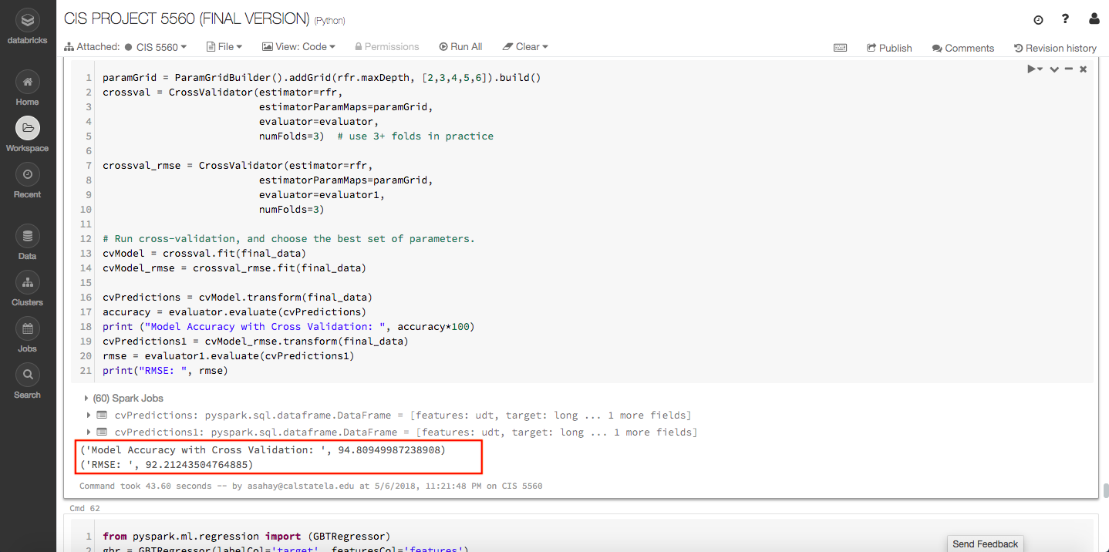
MODEL 2:
ALGORITHM USED: RANDOM FOREST REGRESSION
MODEL ACCURACY WITH CROSS VALIDATION: 94.8094
ROOT MEAN SQUARE ERROR: 92.12

Slide 8
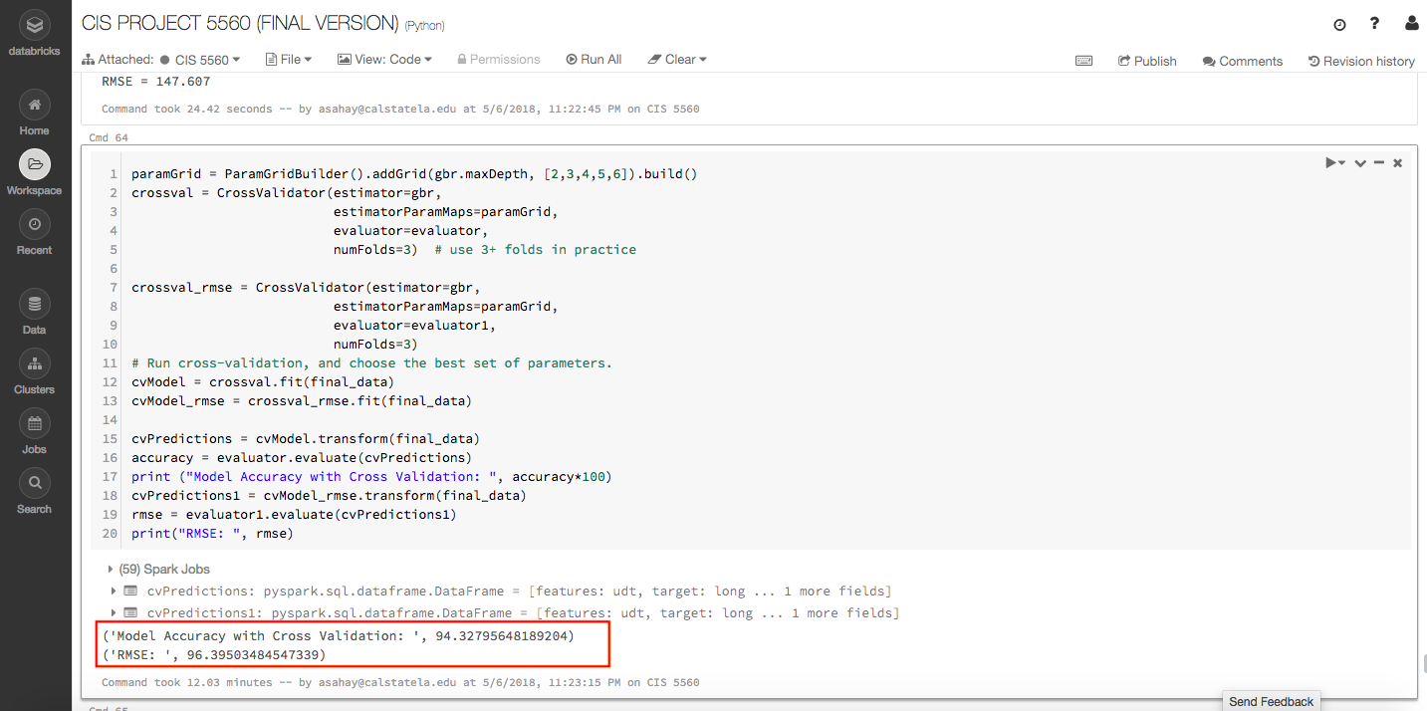
MODEL 3:
ALGORITHM USED: GRADIENT BOOSTING REGRESSION
MODEL ACCURACY WITH CROSS VALIDATION: 94.3279
ROOT MEAN SQUARE ERROR: 96.3950

Slide 9
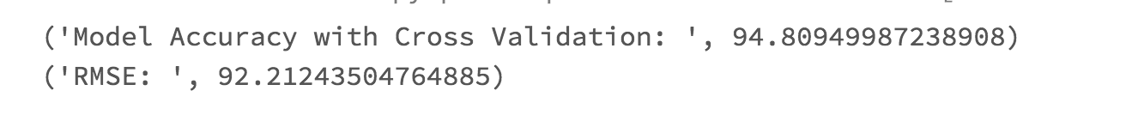
Comparison of Accuracy & RMSE OF DATA Bricks
DECISION TREE REGRESSION
RANDOM FOREST REGRESSION
GRADIENT BOOSTING REGRESSION

Slide 10
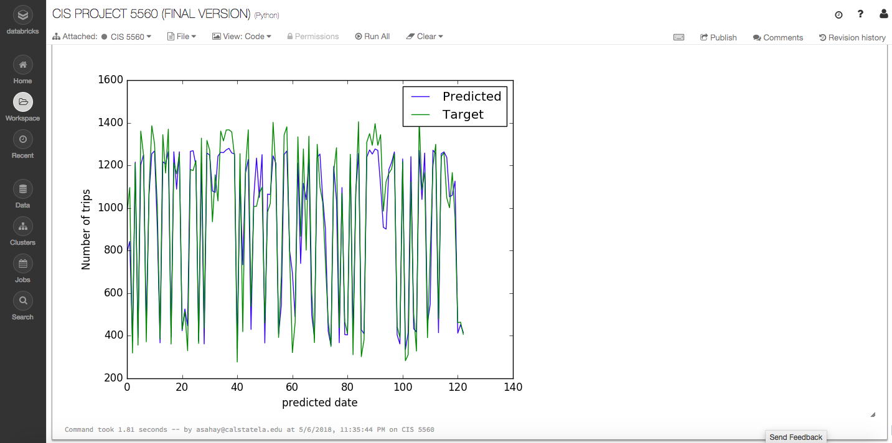
Graph: Random forest regression graph

Slide 11
This graph predicts the the target trips per day v/s the predicted number of trips.
This predictions should give the bike sharing company about the usage of bike trips on a particular day depending on weather forecast, type of day(Business day or Holiday), number of bikes available on a particular station etc.
It will give the company an estimate of traffic congestion that will occur each day.
Future work of the project is that we can create a similar model or a new model to predict the number of trips from each station, predicting when the station will run out of bikes, what will be status of bike in any particular day.
We can also forecast number of trips in the morning to predict number of trips in the afternoon.

Slide 12
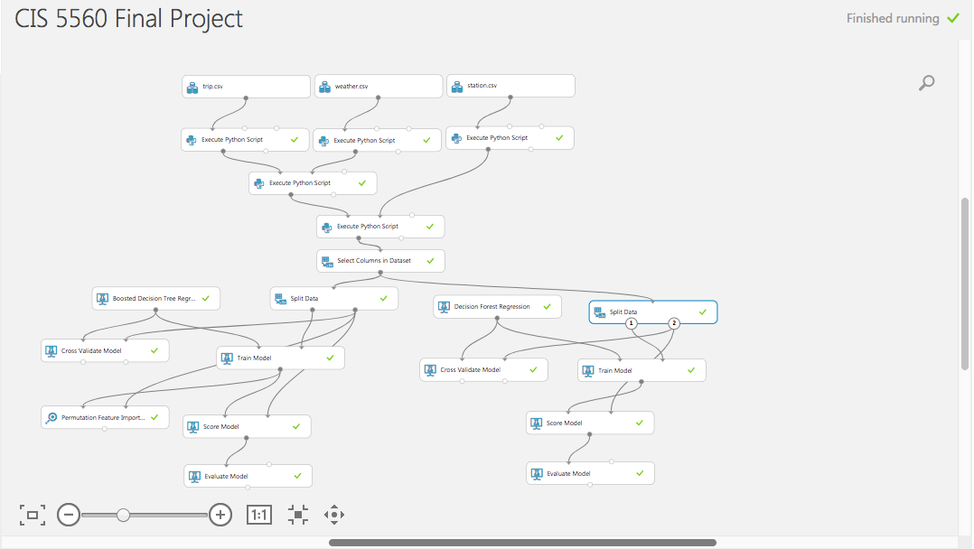
MICROSOFT AZURE MACHINE LEARNING STUDIO

Slide 13
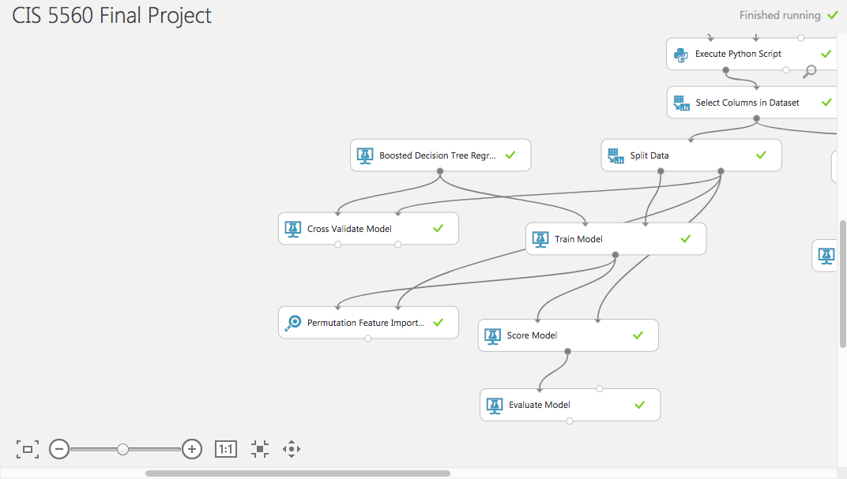
Model 1:

Slide 14
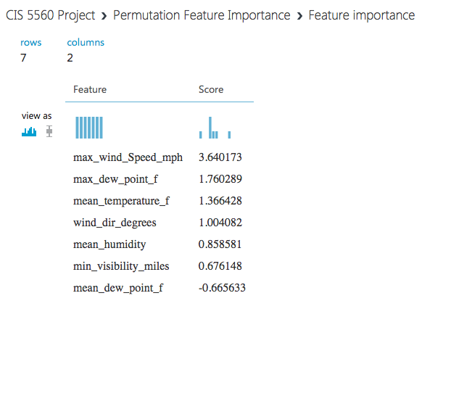
Feature importance In azure ML
The mean_dew_point_f
Is the most important feature
In our table.

Slide 15
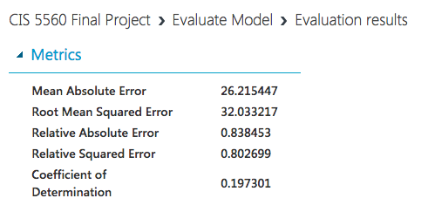
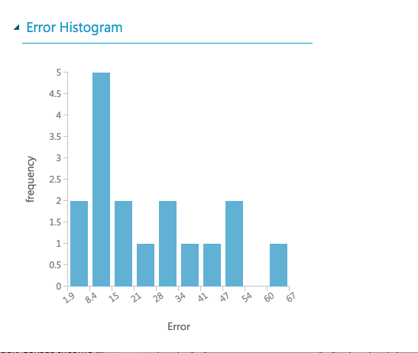
ALGORITHM USED: BOOSTED DECISION TREE REGRESSION
SPLIT DATA is 70-30 and it is Randomized Split
COD is 0.197301
We are checking the feature important to improve the COD of the model.

Slide 16
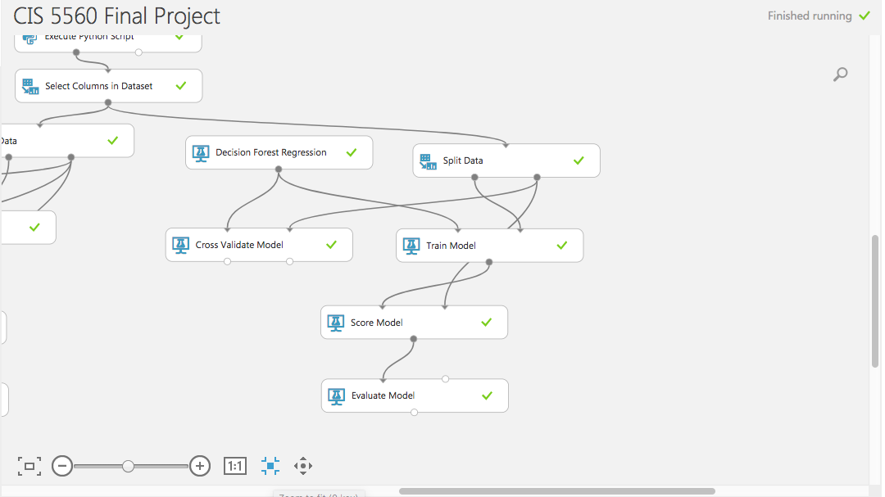
Model 2:

Slide 17
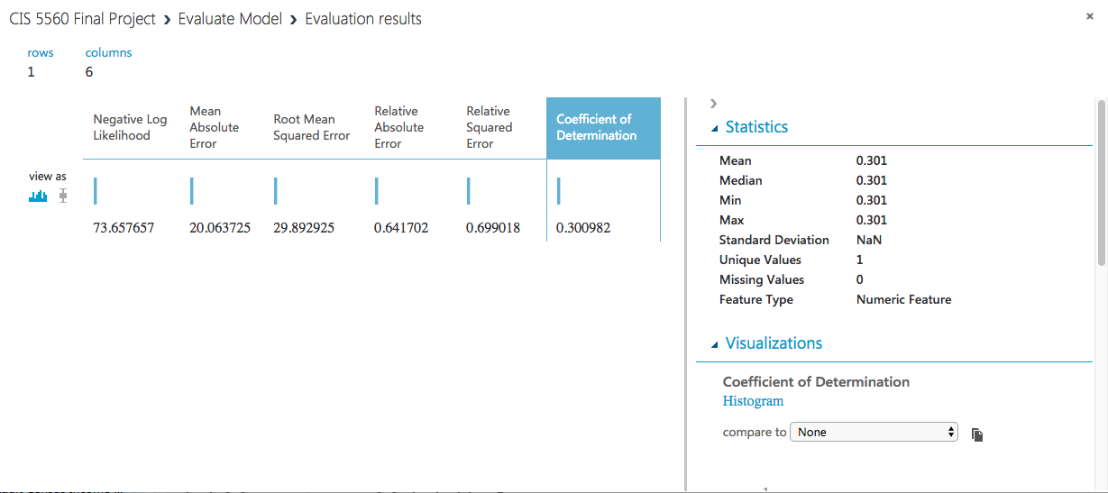
ALGORITHM USED: DECISION FOREST REGRESSION
COD: 0.301
SPLIT DATA : 70 -30 is Randomized split

Slide 18
References:
https://docs.microsoft.com/en-us/azure/machine-learning/studio/create-experiment
https://forums.databricks.com/
https://stackoverflow.com/questions/tagged/databricks
https://docs.microsoft.com/en-us/azure/machine-learning/studio/faq

Slide 19
Microsoft Azure Machine Learning
https://gallery.cortanaintelligence.com/Experiment/CIS-5560-Project-2

Slide 20
Thank you!!!

